Slide 1

MEDAN MAGNET DAN GAYA MAGNET
FISIKA DASAR 2

Slide 2
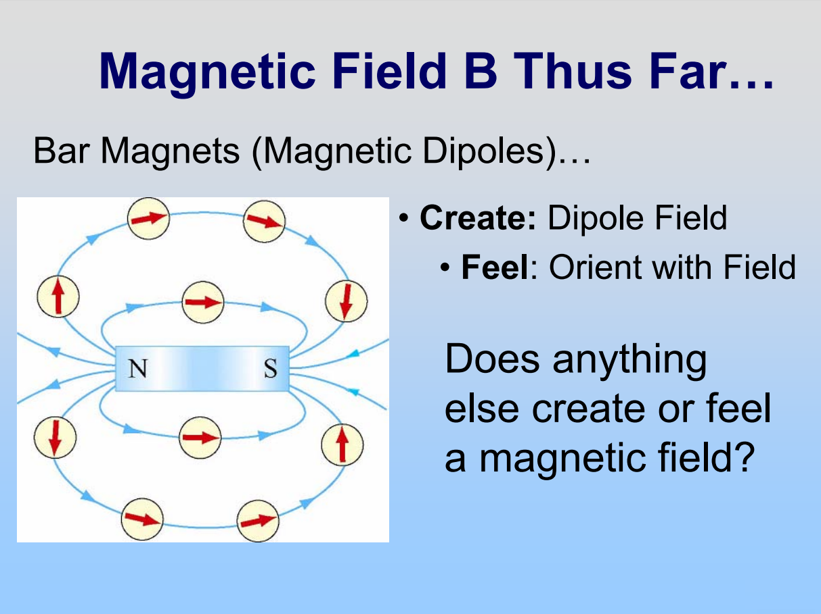

Adopted from MIT Course
2

Slide 3
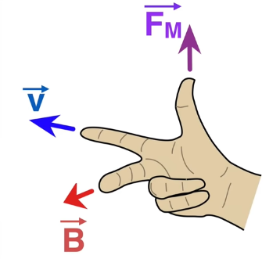
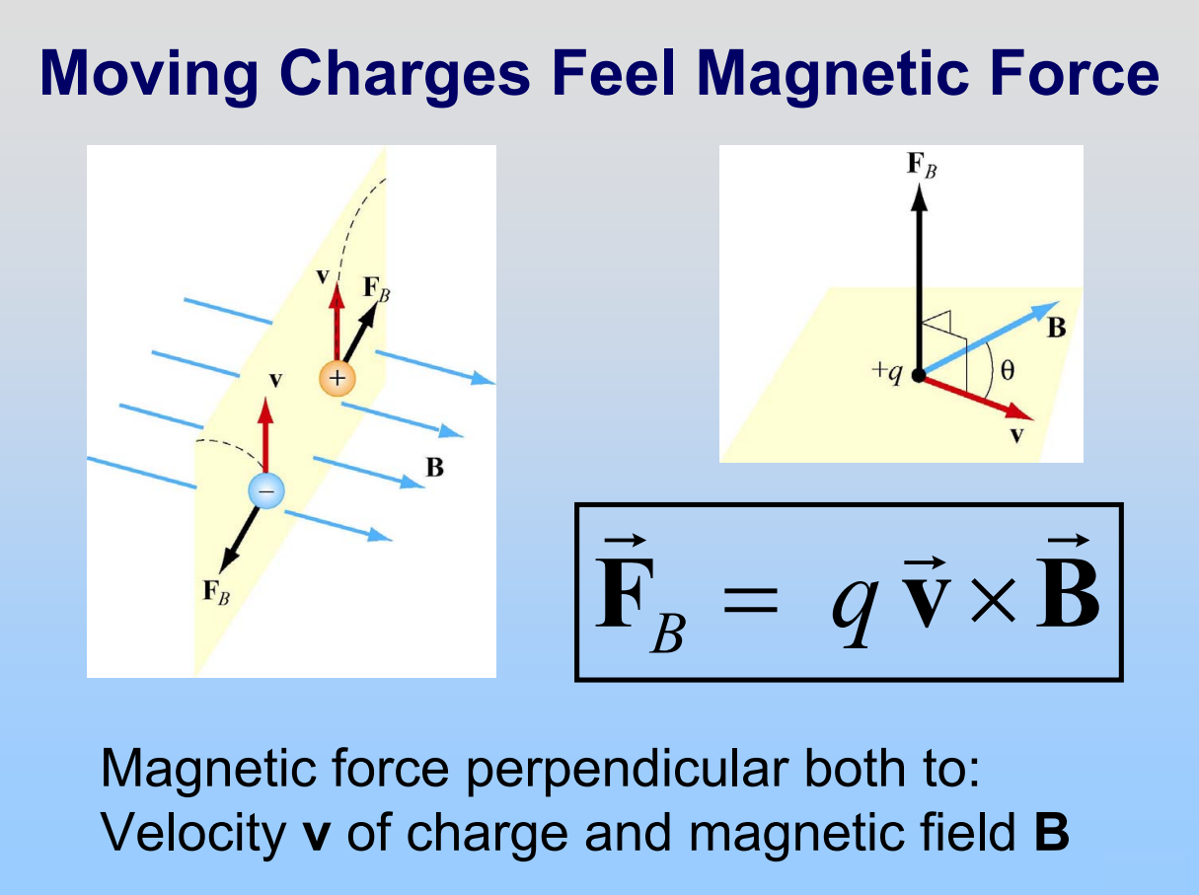
Source: https://www.youtube.com/watch?v=dFT7-_s0jh0
Adopted from MIT Course
3

Slide 4
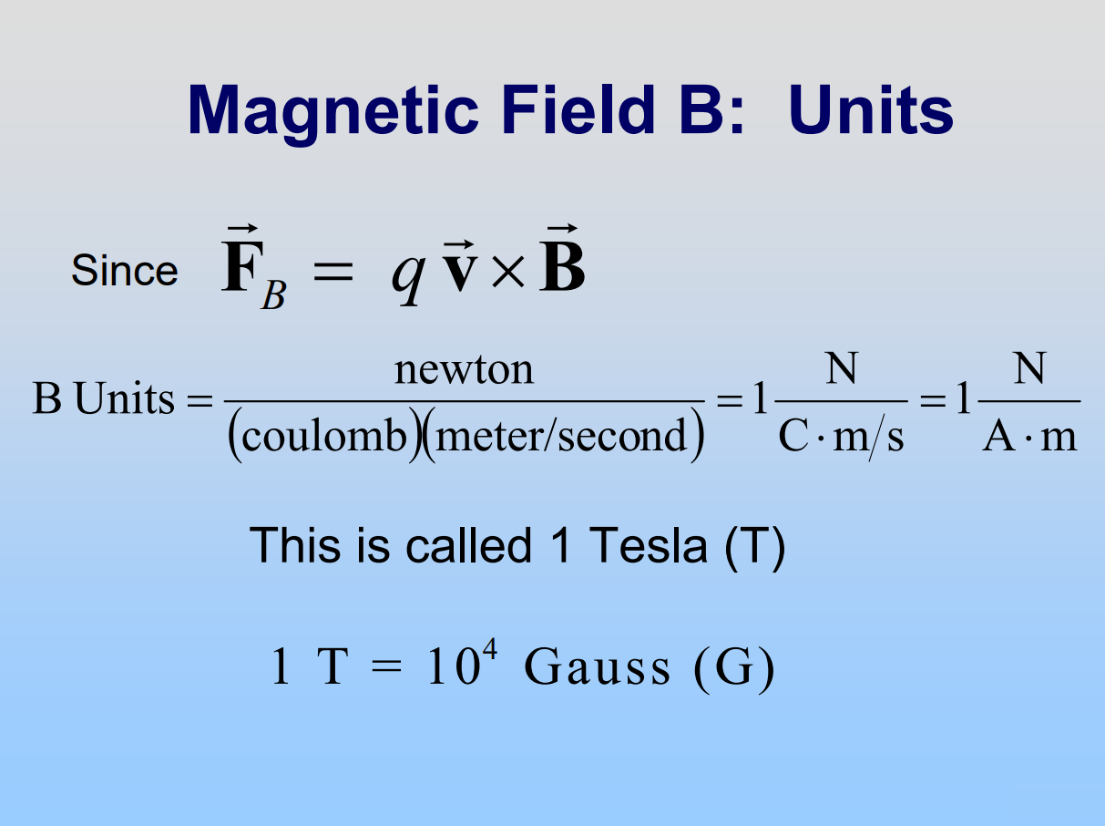
Adopted from MIT Course
4

Slide 5
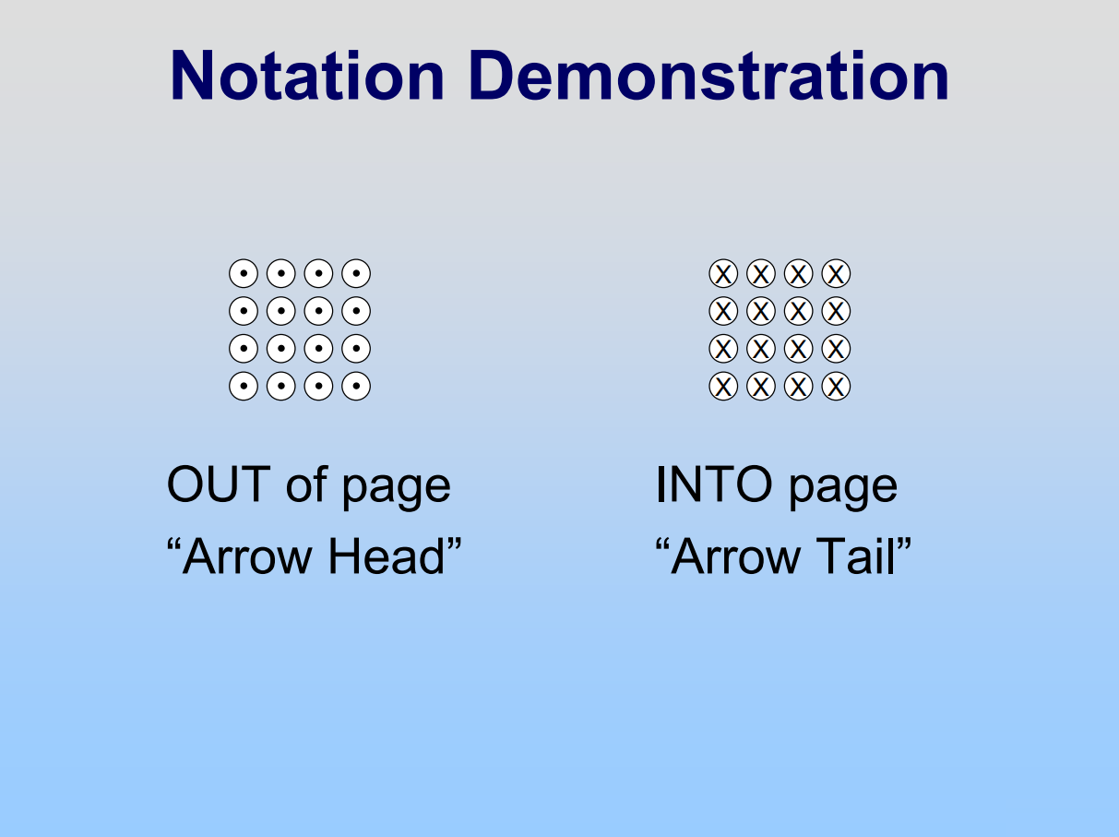

Source: https://www.youtube.com/watch?v=dFT7-_s0jh0
Adopted from MIT Course
5

Slide 6
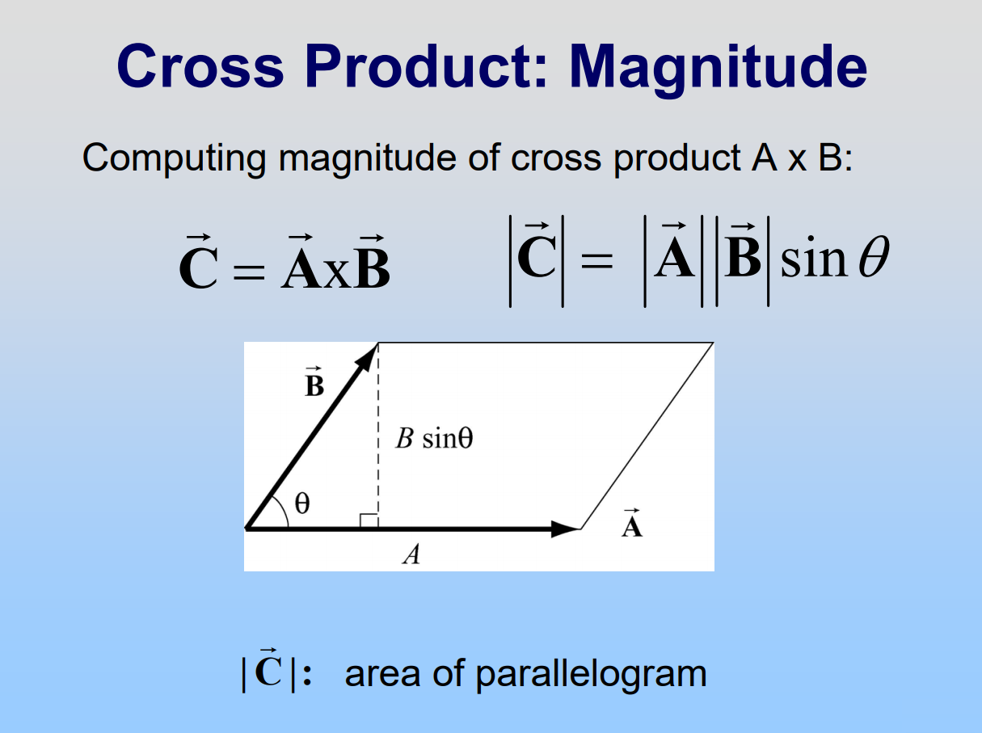
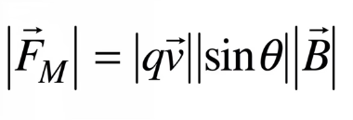
Adopted from MIT Course
6

Slide 7
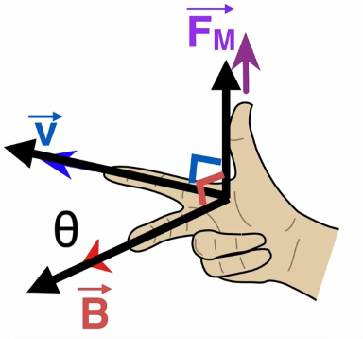
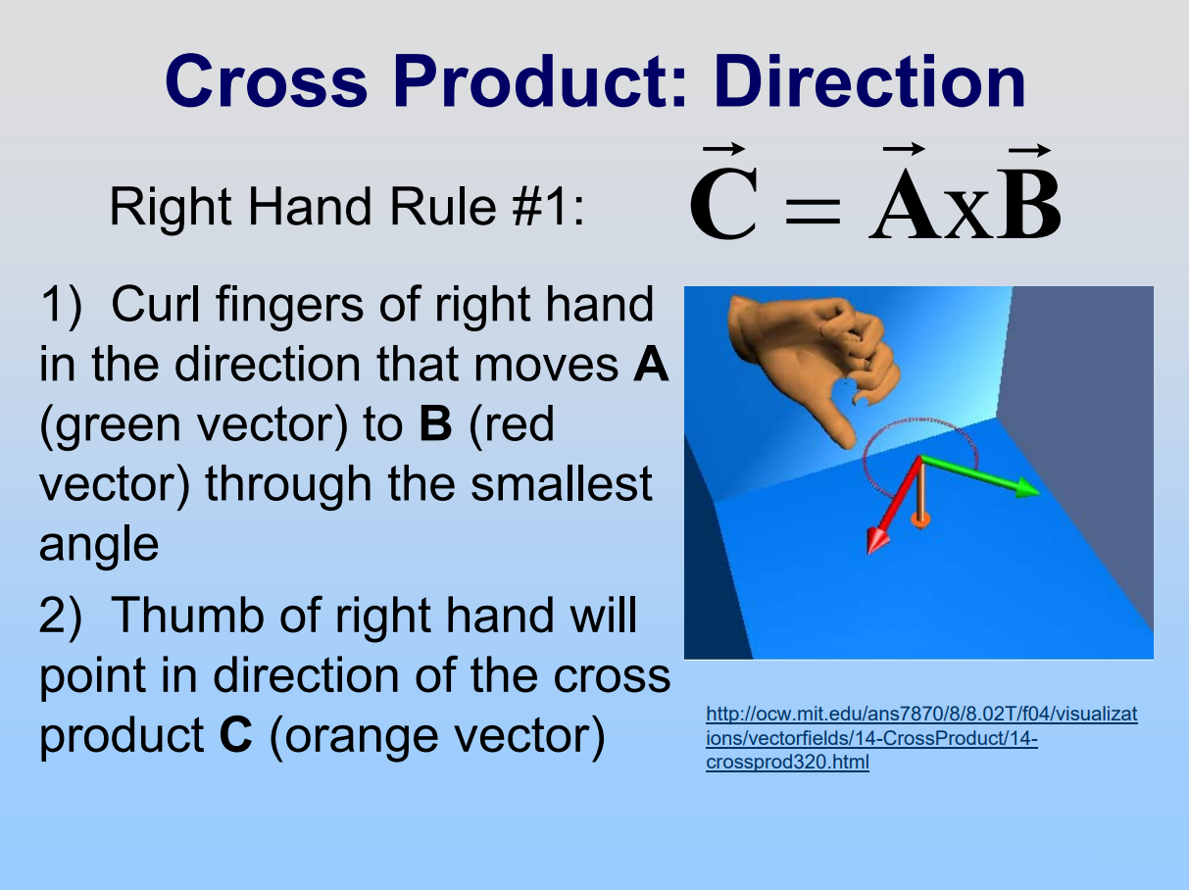
Source: https://www.youtube.com/watch?v=dFT7-_s0jh0
Adopted from MIT Course
7

Slide 8
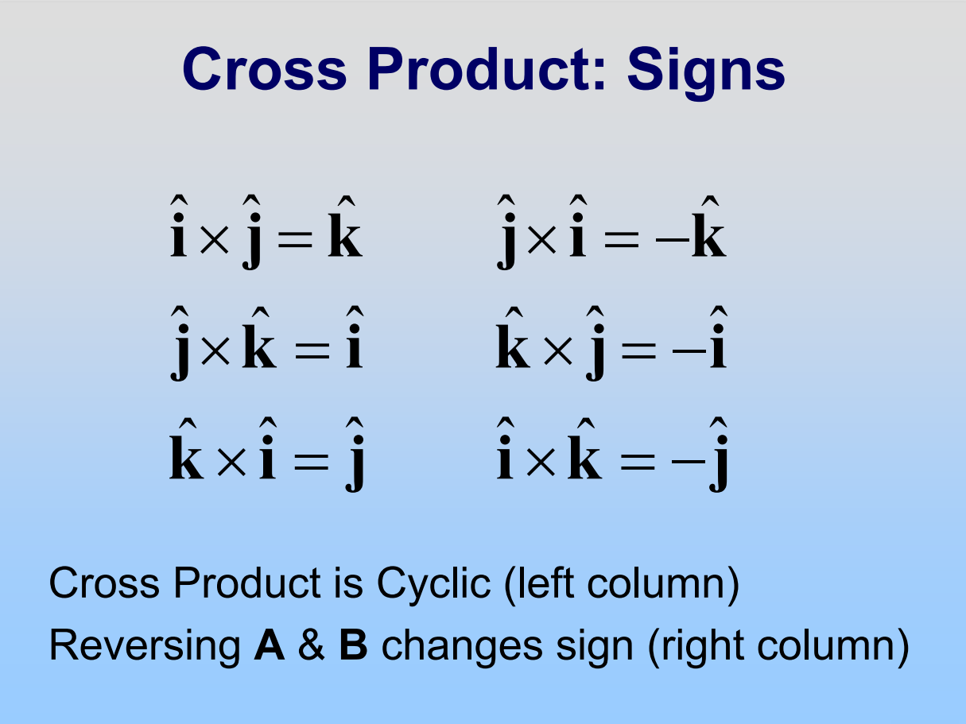
Adopted from MIT Course
8

Slide 9

EXAMPLE
A uniform magnetic field $\vec{B}$, with magnitude 1.2 mT, is directed vertically upward throughout the volume of a laboratory chamber. A proton with kinetic energy 5.3 MeV enters the chamber, moving horizontally from south to north. What magnetic deflecting force acts on the proton as it enters the chamber? The proton mass is $1.67×{10}^{−27}$ kg. (Neglect Earth’s magnetic field)
Adopted from Halliday & Resnick, Fundamental of Physics 10th Edition, Wiley
9

Slide 10

To find the magnitude of ${\vec{F}}_{B}$we first find the proton’s speed $v$. We can find $v$ from the given kinetic energy because $K= \frac{1}{2}mv^{2}$. Solving for $v$, we obtain
$$v= \sqrt{\frac{2K}{m}=\frac{(2)(5.3)(1.60 × {10}^{−13})}{1.67 × {10}^{−27}}}=3.2 × {10}^{7}m/s$$
$$F_{B}= \left|q\right|v B\sin{ϕ}=(1.60 × {10}^{−19})(3.2 × {10}^{7})(1.2 × {10}^{−3})(\sin{90°)}=6.1 ×{10}^{−15} N$$
To find the direction of ${\vec{F}}_{B},$ we use the fact that ${\vec{F}}_{B}$ has the direction of the cross product $q\vec{v} × \vec{B}$. Because the charge $q$ is positive, ${\vec{F}}_{B}$ must have same direction as $\vec{v} × \vec{B}$, which can be determined with right-hand rule for cross products. We know that $\vec{v}$ is directed horizontally from south to north and $\vec{B}$ is directed vertically up. The right-hand rule shows us that the deflecting force ${\vec{F}}_{B}$ must be directed horizontally from west to east. If the charge of the particle were negative, the magnetic deflecting force would be directed in the opposite direction – that is, horizontally from east to west.
Adopted from Halliday & Resnick, Fundamental of Physics 10th Edition, Wiley
10

Slide 11
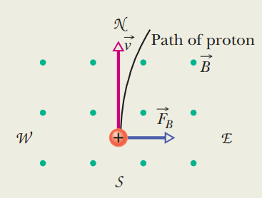
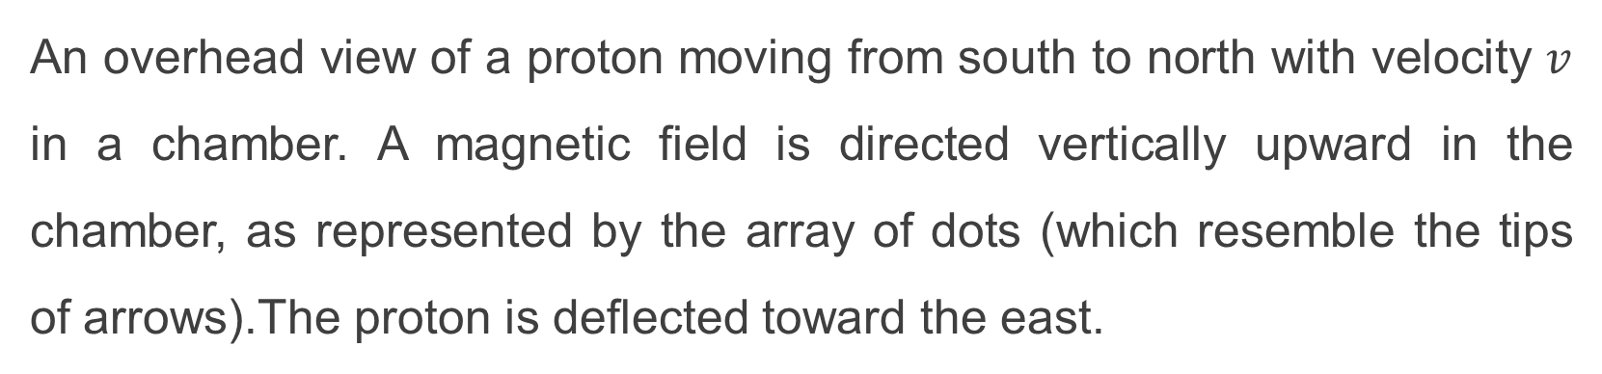
Figure from Halliday & Resnick, Fundamental of Physics 10th Edition, Wiley
An overhead view of a proton moving from south to north with velocity $v$ in a chamber. A magnetic field is directed vertically upward in the chamber, as represented by the array of dots (which resemble the tips of arrows).The proton is deflected toward the east.
Adopted from Halliday & Resnick, Fundamental of Physics 10th Edition, Wiley
11

Slide 12
SEKIAN - TERIMAKASIH

